Slide 1

Data Management-2
Team Members
Rakesh Nagaragatta Jayanna (11038062).
Gurudarshan Bangalore Nagaraju (11037886).
Darpen Bhandari (11038426).
Rajat Pundir (11037395)
Team 4 : ARD

Slide 2
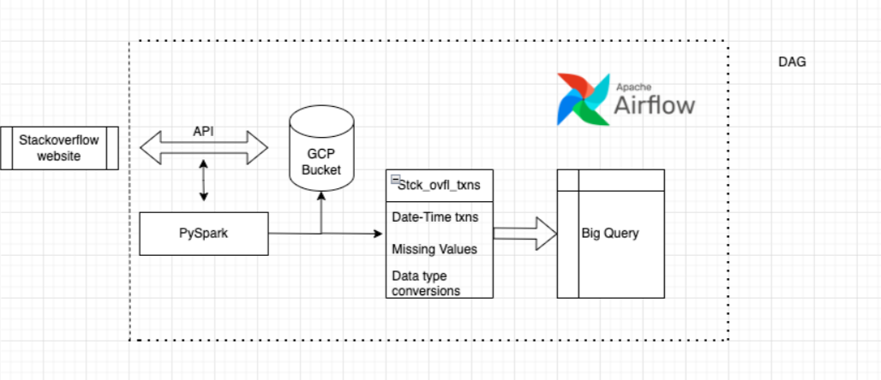
Architecture Diagram for Stack overflow website

Slide 3
Data Pipeline Flow Explanation
1. Data Fetching (Stack Overflow API):
The pipeline begins by fetching raw data from the Stack Overflow website via an API using PySpark, and the data is then stored in a GCP bucket.
The data collected includes information on topics such as questions, answers, tags, and user interactions.
2. Data Transformation and Processing (PySpark):
PySpark is utilized for initial data extraction and processing.
The raw data retrieved through the API is transformed and stored back in the bucket.
PySpark scripts manage data cleaning tasks such as converting date and time to a standard format, handling missing values, and Data type conversions.

Slide 4
3. Airflow DAG Structure and Scheduling
The Airflow job is structured as a Directed Acyclic Graph (DAG) with tasks organized to handle data extraction, transformation, and loading (ETL) from start to finish.
The DAG is scheduled to run once a day, ensuring that Stack Overflow user data is regularly updated by fetching the latest information daily.
4. Data Extraction and Storage in Cloud Bucket
The first task in the Airflow job calls the Stack Overflow API to retrieve users data.
PySpark, integrated within the Airflow DAG, is used to fetch and process raw data from the API.
The fetched data is stored in a Google Cloud Storage (GCS) bucket, creating a reliable storage location for raw data that’s accessible for further processing.
5. Data Transformation with PySpark
Once data is stored in the GCS bucket, a separate Airflow task picks up the data for transformation.
PySpark scripts handle data cleaning and transformation, including:
Converting date and time fields into a standardized format.
Handling missing values and normalizing text fields to maintain consistency.
After transformation, the cleaned data is loaded back to BigQuery and saved back to the GCS bucket in a transformation folder .

Slide 5
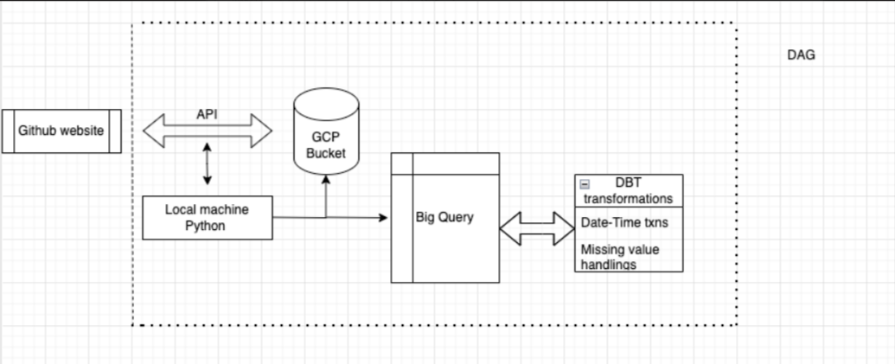
Data Processing Using GitHub API

Slide 6
Data Processing Using GitHub API
1. Data Source and extraction using GitHub API:
Collected data from GitHub website using API which consisted of website user information such as: Username, ID, repositories, company etc.
The above step was implemented using a Python script on local machine.
2. Leveraging Bucket for data storage on GCP:
The raw data collected from GITHUB website using API's is stored in a Google cloud storage bucket (GCS).
3. Loading of data to BigQuery:
The raw dataset is loaded into BigQuery using code from a Python file running on local machine.

Slide 7
4. ELT using DBT:
Once connection is established, desired transformation steps are then identified.
SQL queries are then executed in DBT to achieve data transformations.
5. Data Transformation steps(DBT):
Data Cleaning: Missing value handlings.
Transformation: Data type & date-time stamp conversion to a standardized format.
6. Transformed Data:
The newly transformed data is then stored back in a new CSV file in BigQuery.
The dataset is then in a readily usable format for analysis and deriving insights.

Slide 8
Challenges in implementation:
API Rate Limits: This will impede the number of times one can call the Stack Overflow & GitHub API, which could reduce real-time data flow. Any downtime to the pipeline may be frequent.
Data Latency: There might be slight delays with insights in real time due to the processing time involved in data extraction, cleaning, and transformation.
Scalability Issue: Volume can create a bottleneck when being processed on a local machine. Potential migration of data processing may be required to be performed on the cloud.
DAG Complexity: Besides, the maintenance of multi-step DAGs requires continuous monitoring for the sake of smooth processing.

Slide 9
Q&A
09

Slide 10
Thank you

